Slide 1

Rami Wail, Ahmed Alaa, Mohamed Hatem
201600112 - 201600352-201600075
DG - FinFet: Project Presentation
Supervised by : Dr Amr Bayoumi.
Naneng 520

Slide 2
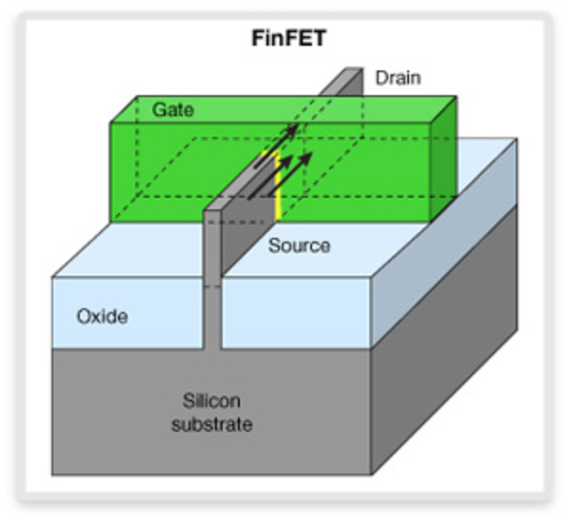
Introduction
FinFET(Fin Field Effect Transistor) named fin because the source /drain region form a fin on the silicon surface
prefered gate design in CMOS from 14 nm to 7 nm due to its many superior attributes.

Slide 3
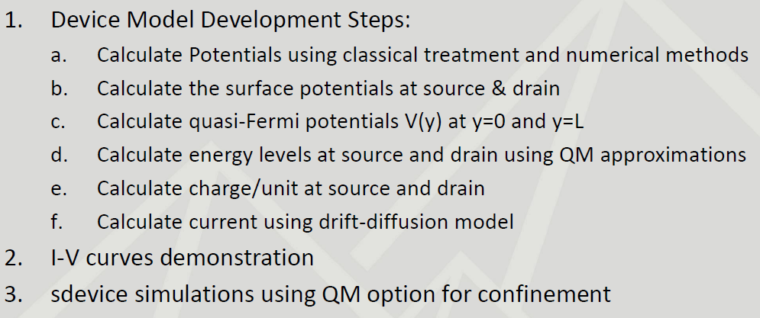
Procedure

Slide 4
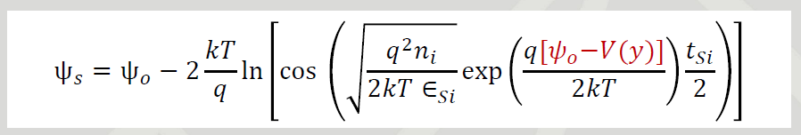
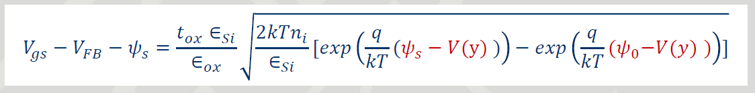
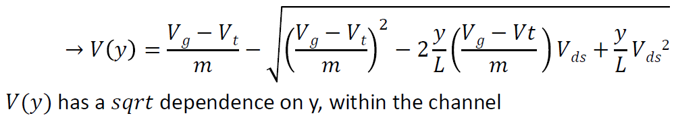
Classical Model

Slide 5
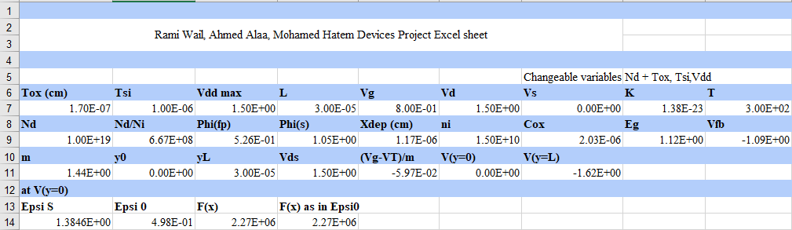
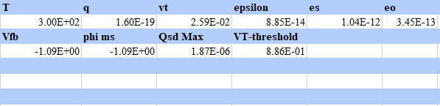
Excel calculations

Slide 6

Newton raphson method

Slide 7
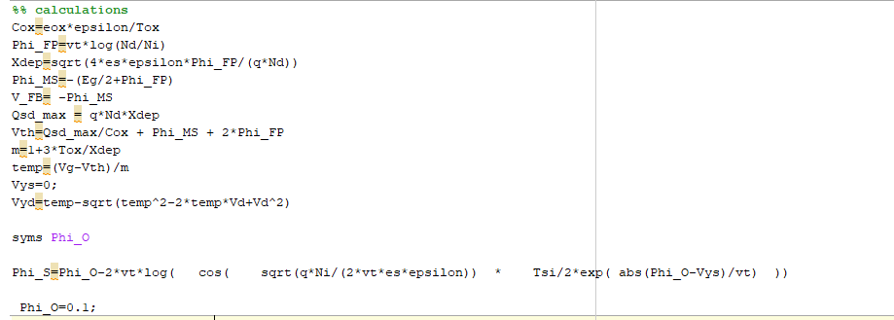
Matlab - Numerical

Slide 8
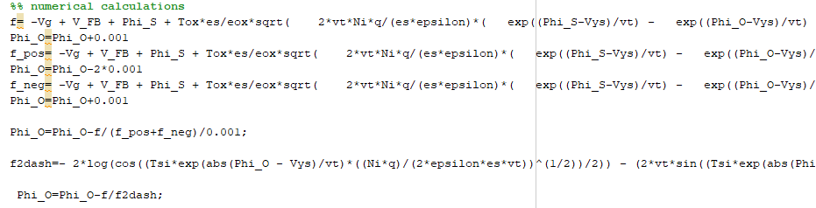
Numerical calculations

Slide 9
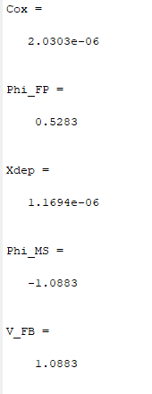
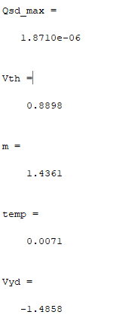
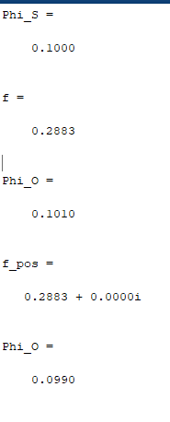
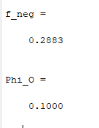
Output

Slide 10
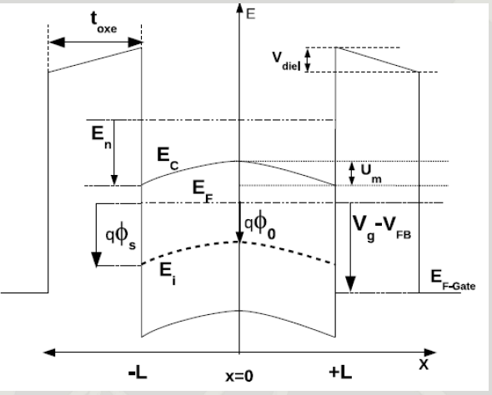
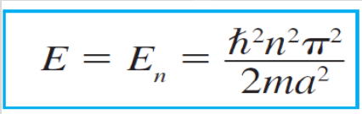
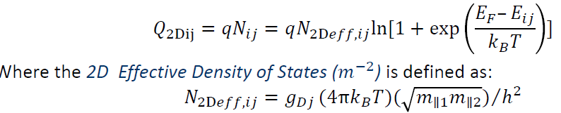
Quantum model
Reprinted from A. Bayoumi,"Analysis of Dual Gate Structures Using Double-Well and WKB Quantization Rules", IEEE Transactions on Electron Devices, Volume: 63 , Issue: 9 , Sept. 2016

Slide 11
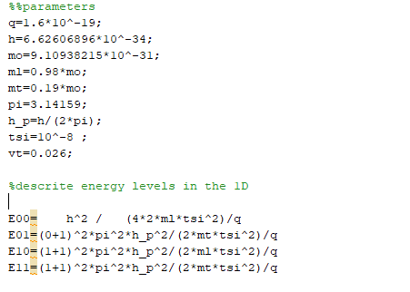
Quantum modeling - Matlab

Slide 12
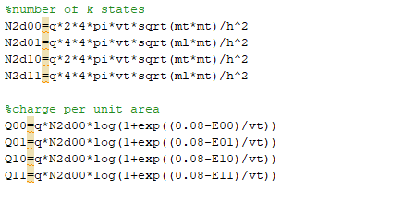
Quantum modeling - Matlab

Slide 13
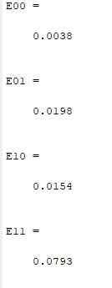
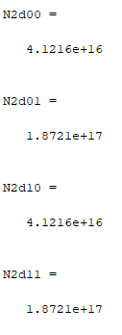
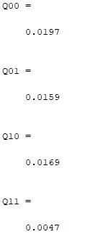
Quantum modeling - Matlab output

Slide 14
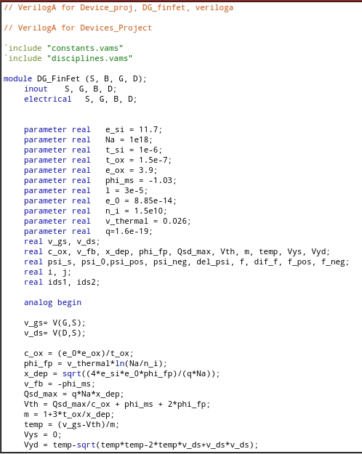
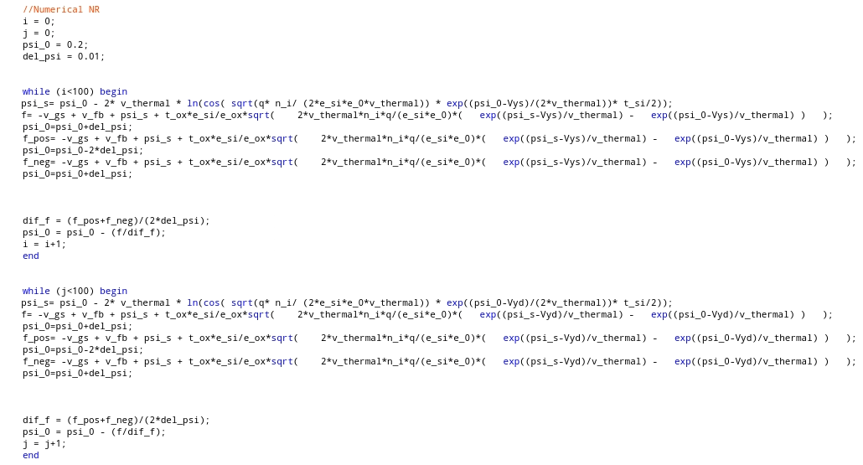
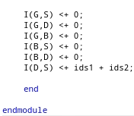
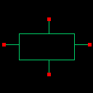
Verilog a

Slide 15
Thank you

